Slide 1
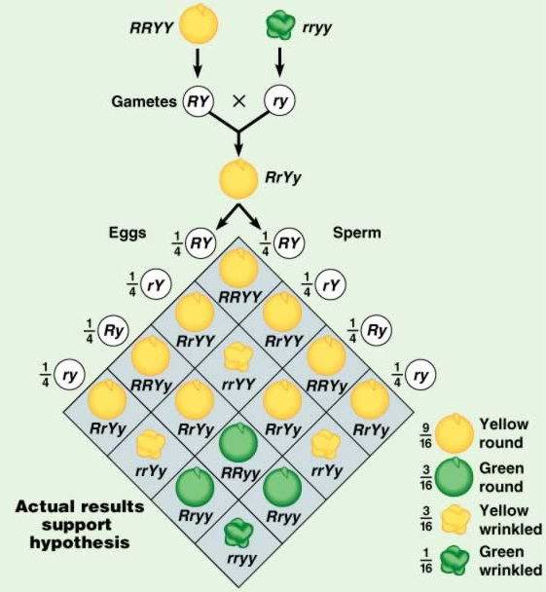
CHAPTER - 5
PRINCIPLES OF INHERITANCE AND VARIATION – DIHYBRID CROSS, TEST CROSS

Slide 2
Terminologies in Genetics:
Factor or Gene: Functional unit of heredity responsible for the expression of character in the progeny.
Locus: The position of the gene on the chromosomes.
Allele: The alternative form of a gene for a contrasting character present on identical locus of homologous chromosomes.

Slide 3
Inheritance of two gene:
Mendel’s 2nd law or Law of independent assortment:
It states that, ‘factors for different pairs of contrasting characters in a hybrid assorted (distributed) independently during gamete formation.
Dihybrid cross: The cross between two parents, which differs in two pairs of contrasting characters.

Slide 4
Dihybrid cross:
Parents phenotype
Round Yellow
Wrinkled Green
RRYY
RY
rryy
ry
genotype
gametes
RrYy
Round Yellow
F1 generation

Slide 5
Phenotypic ratio : 9 : 3 : 3 : 1

Slide 6
Dihybrid test cross.
F1 hybrid is crossed with recessive green wrinkled pea plant.
Recessive green wrinkled – rryy, Gamet ry
F1 hybrid : round yellow- RrYy, Gamets: RY, Ry, rY, ry.
Gam ets | RY | Ry | rY | ry
ry | RrYy | Rryy | rryY | rryy
Phenotypic ratio – 1 : 1 : 1 :1

Slide 7
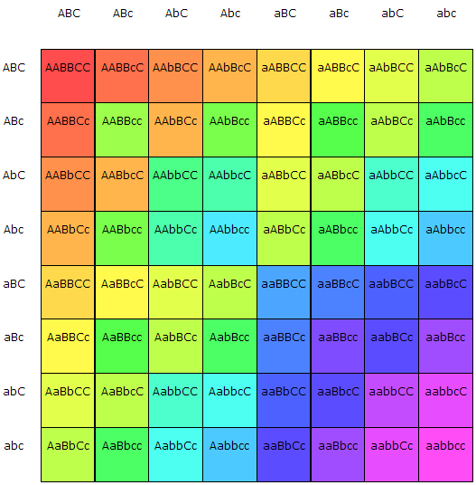
TRI HYBRID CROSS

Slide 8
TEST CROSS
Crossing of F1 individual having dominant phenotype with its homozygous recessive parent is called test cross.
The test cross is used to determine whether the individuals exhibiting dominant character are homozygous or heterozygous.

Slide 9
TEST CROSS
4:0 ratio
Unknown is homozygous dominant
TT X tt
 | T | T
t | Tt | Tt
t | Tt | Tt

Slide 10
Test cross
2:2 ration
Unknown is heterozygous
Tt X tt
 | T | t
t | Tt | tt
t | Tt | tt

Slide 11
BACK CROSS

